Slide 1

PRESENTATION TEMPLATES
Stories worth telling…
WWW.POWERSLIDES.COM
Notes:
There is a background placeholder in this slide.
To change the images :
Right Click and Select Format Background -> Select FILL -> Picture Or Texture Fill -> Select File...

Slide 2





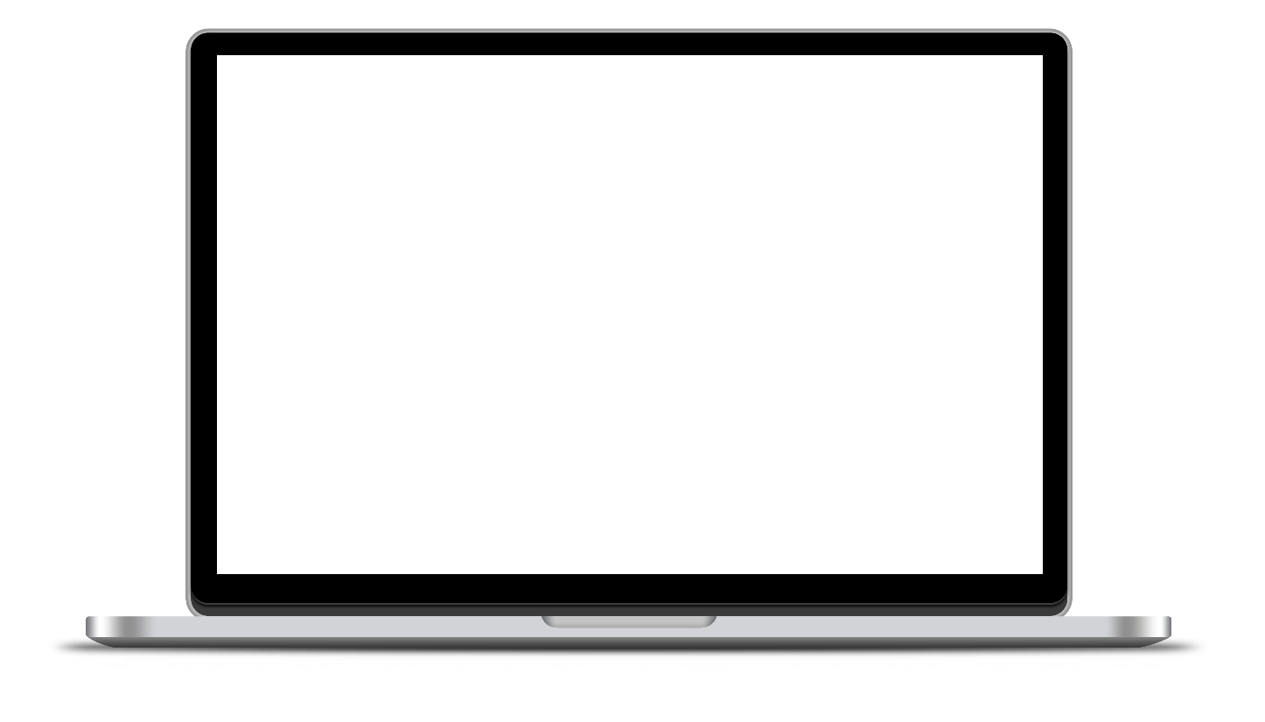


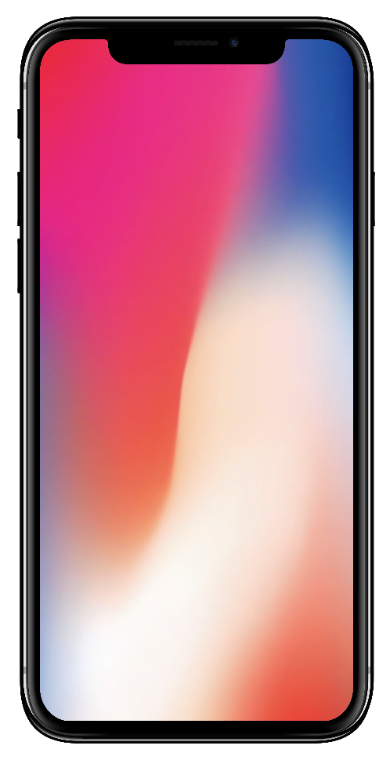

MULTIPLE DEVICE MOCKUP
Smart Devices
Nvidia GTX chip to enable you enjoy your gaming experience
Devices to provide you with your ultimate desire when working without glitch
High resolution screens to provide you with a great viewing experience
40%
Solid State Drives allowing your screen to boot faster
Mobile
40% of the company sales are from the mobile section
POWERSLIDES WWW.POWERLIDES.COM
1

Slide 3
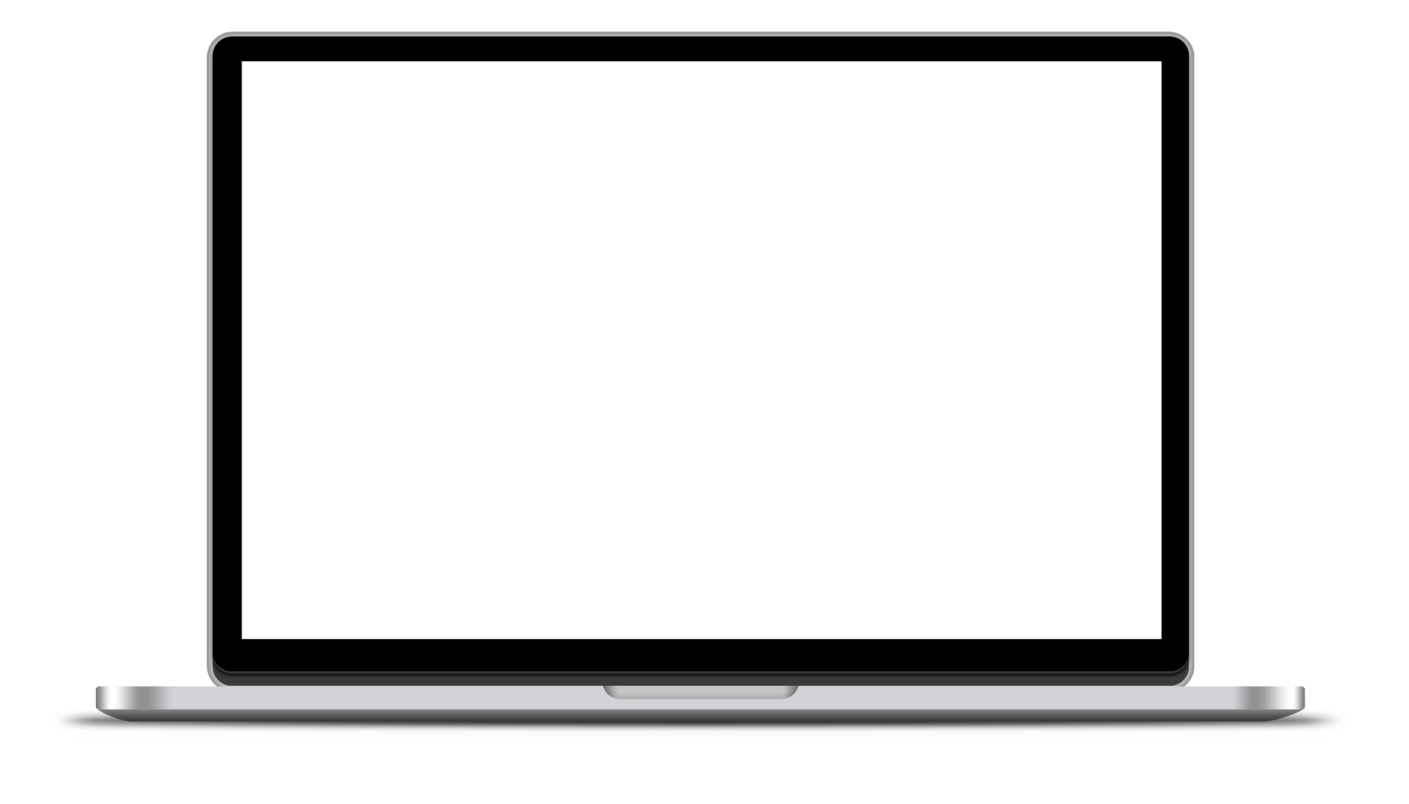



MULTIPLE DEVICE MOCKUP
Powerslides Laptop
40%
Power
Long-power to surf, stream and more
Flexible
Snappy solid state drive for seamless performance and reliable multitasking
Touchscreen
Allowing you to quickly access and input important information
POWERSLIDES WWW.POWERLIDES.COM
2

Slide 4
MULTIPLE DEVICE MOCKUP
Battery
01
Connection
02
17 hours video playback
5G LTE
Display
03
Height
04
Super Retina XDR, 6.1-inch
5.78 inches
Material
05
Weight
06
Stainless Steel
5.78 ounces
POWERSLIDES WWW.POWERLIDES.COM
3

Slide 5

MULTIPLE DEVICE MOCKUP
Powerslides iWATCH
40%
Smartwatches can do everything a smartphone is capable of doing, as well as measure certain biometric information such as heart rate, respiration rate, blood oxygen saturation, and sleep patterns
01
02
03
Tracking
Direct Calls
Internet
It helps you to track your items once you’ve connected them
You can make and answer calls directly from the watch
Surf the internet without limit
POWERSLIDES WWW.POWERLIDES.COM
4

Slide 6

MULTIPLE DEVICE MOCKUP
Smart TV
Smart
Affordable
High Definition
01
02
03
Stream On-Demand
NETFLIX
Web Browser
You can stream anything you want in an instant
Netflix and chill in HD without interruptions
The built-in web browser in a smart TV enables you to access the internet
POWERSLIDES WWW.POWERLIDES.COM
5

Slide 7

THANK YOU
Do you a need bespoke presentation design service? We can custom create your slides from scratch. Contact us today.
WWW.POWERSLIDES.COM
Notes:
There is a background placeholder in this slide.
To change the images :
Right Click and Select Format Background -> Select FILL -> Picture Or Texture Fill -> Select File...

